Slide 1
INT331:FUNDAMENTALS OF DEVOPS
course overview
LTP : 2 0 2 CREDITS : 3
Text Book:
LINUX POCKET GUIDE: ESSENTIAL COMMANDS by DANIEL J. BARRETT, O'REILLY
Reference books:
1. DEVOPS: A SOFTWARE ARCHITECT'S PERSPECTIVE (SEI SERIES IN SOFTWARE ENGINEERING) by LEN BASS , INGO WEBER, LIMING ZHU, ADDISON-WESLEY

Slide 2
Unit I
Introduction to Software Development

Slide 3
What is software engineering
The term software engineering is composed of two words, software and engineering.
Software is more than just a program code.
Engineering on the other hand, is all about developing products.
NEED OF SOFTWARE ENGINEERING.
Large software.
Scalability.
Cost.
Dynamic Nature.
Quality Management.

Slide 4
What is Software Development
Software development is the process of designing, creating, testing, and maintaining computer programs and applications.
Key phases and activities involved in software development include:
Requirement Analysis.
Design.
Implementation/Coding.
Testing.
Deployment.
Maintenance.
Software development can follow various methodologies, such as the Waterfall model, Agile, Scrum, or DevOps.

Slide 5
What is Software Development….
Additionally, software development can be categorized into different types, including:
Desktop Application Development.
Web Development.
Mobile App Development.
Embedded Systems Development.
Software development plays a vital role in shaping modern technology and impacts virtually every aspect of our daily lives

Slide 6
Software Development Life Cycle
The Software Development Life Cycle (SDLC) is a structured and systematic approach used by software development teams to plan, design, build, test, deploy, and maintain software applications.
The typical phases of the Software Development Life Cycle include:
Requirement Analysis.
Design.
Implementation/Coding.
Testing.
Deployment.
Maintenance.

Slide 7
Software Development Life Cycle…
The SDLC can follow various methodologies, including:
Waterfall Model.
Iterative waterfall model
Prototype model
Evolutionary model
Spiral model
Agile model
The choice of SDLC methodology depends on factors such as project complexity, team size, project requirements, and organizational preferences.

Slide 8
Traditional Models for SDLC
Traditional models for the Software Development Life Cycle (SDLC) are sequential and linear approaches that follow a well-defined set of phases.
Some of the prominent traditional SDLC models include:
Waterfall Model
V-Model (Verification and Validation Model)
Spiral Model
Incremental Model
Iterative Model
It's worth noting that traditional SDLC models have certain limitations, such as the difficulty of accommodating changing requirements and the potential for long development cycles.

Slide 9
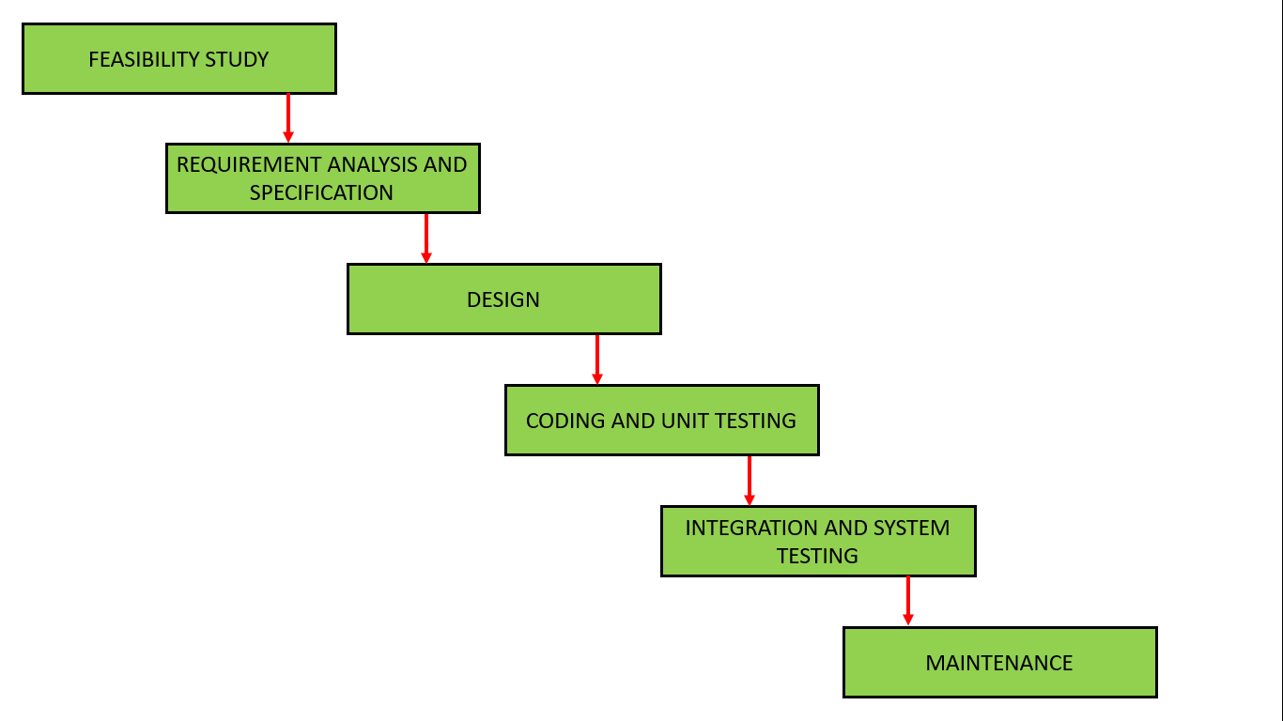
Let's elaborate on each of the Software Development Life Cycle (SDLC) models we mentioned:
Waterfall Model

Slide 10
Waterfall Model..
Advantages of the Classical Waterfall Model
Easy to Understand: Simple and easy to grasp.
Individual Processing: Phases processed one at a time.
Properly Defined: Each stage has a clear definition.
Properly Documented: Processes and results are well-documented.
Works for Smaller Projects: Suitable for smaller projects with well-understood requirements.

Slide 11
Disadvantages of the Classical Waterfall Model
The Classical Waterfall Model suffers from various shortcomings
No Feedback Path: Assumes no developer errors in any phase.
Difficult Change Accommodation: Assumes complete and accurate customer requirements at the beginning.
No Overlapping Phases: New phases start only after the completion of previous ones.
Late Defect Detection: Testing occurs toward the end of the development process.
5.Not Suitable for Complex Projects: Not ideal for handling complex projects due to its linear nature.
6.Heavy weight Model: Rigid and sequential nature.

Slide 12
Applications of Classical Waterfall Model
Safety-Critical Systems: Used in aerospace or medical systems where errors can have severe consequences.
Government and Defense Projects: Offers a structured approach to meet requirements and deadlines.
Projects with well-defined Requirements: Suited for projects with clear objectives and scope.
Projects with Stable Requirements: Well-suited for projects without frequent changes after completing phases.

Slide 13
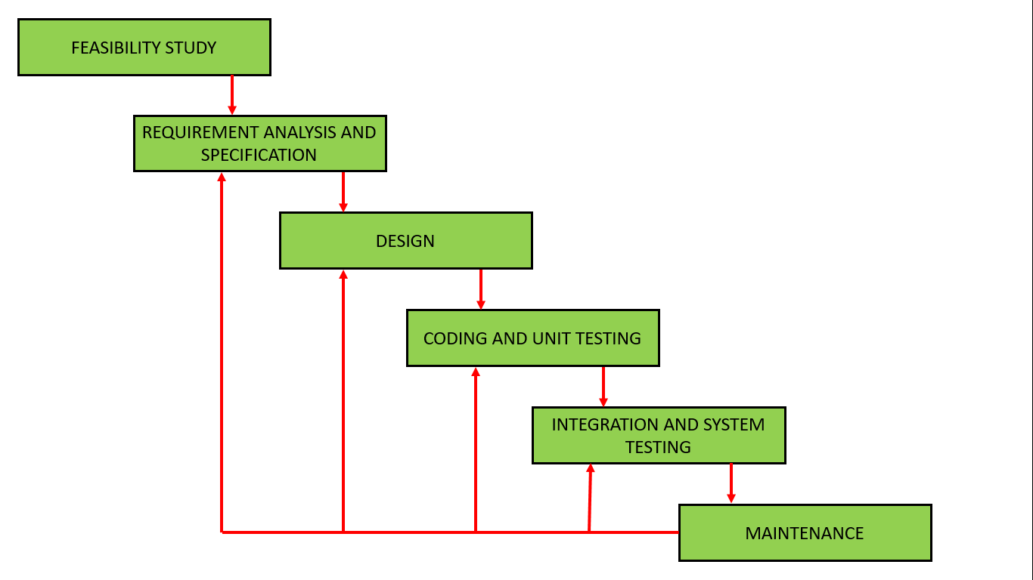
Iterative waterfall model
The Iterative waterfall model improves the classical waterfall model for practical software development.

Slide 14
Iterative waterfall model
When to use the Iterative Model?
When requirements are defined clearly and easy to understand.
When the software application is large.
When there is a requirement of changes in future.
Advantage(Pros) of Iterative Model:
Testing and debugging during smaller iteration is easy.
A Parallel development can plan.
It is easily acceptable to ever-changing needs of the project.
Risks are identified and resolved during iteration.
Limited time spent on documentation and extra time on designing.

Slide 15
Iterative waterfall model
Disadvantage(Cons) of Iterative Model:
1.More Resources may be required.
2.Design can be changed again and again because of imperfect requirements.
3.Requirement changes can cause over budget.
4.Project completion date not confirmed because of changing requirements.

Slide 16
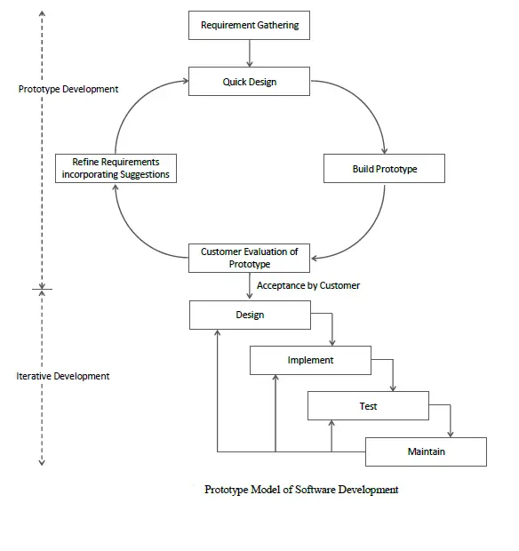
Prototype Model
Build working prototype before actual software development
Prototype is basic, limited functionality, and less reliable
Useful when detailed requirements are unclear
Suitable for clients with a general idea of software needs

Slide 17
Prototype Model
Advantage of Prototype Model
Reduce the risk of incorrect user requirement
Good where requirement are changing/uncommitted
Regular visible process aids management

Slide 18
Prototype Model
Disadvantage of Prototype Model
Require extensive customer collaboration
Costs customer money
Needs committed customer
Difficult to finish if customer withdraw
May be too customer specific, no broad market
Difficult to know how long the project will last.
Prototyping tools are expensive.
Special tools & techniques are required to build a prototype.
It is a time-consuming process.

Slide 19
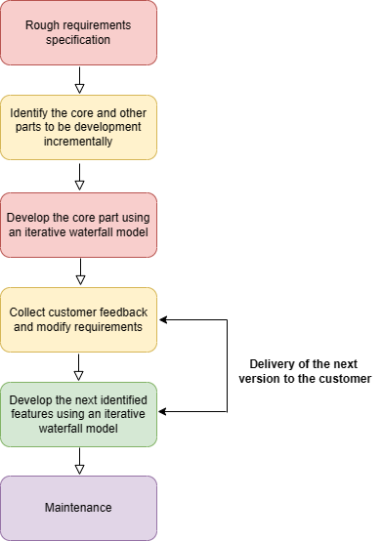
Evolutionary model

Slide 20
Evolutionary model
Evolutionary model is a combination of Iterative and Incremental model of software development life cycle.
Incremental model first implement a few basic features and deliver to the customer. Then build the next part and deliver it again and repeat this step until the desired system is fully realized.
Iterative model main advantage is its feedback process in every phase.
Also known as "Design a little, build a little, test a little, deploy a little model".

Slide 21
Evolutionary model
Used in large projects with modular implementation.
Commonly applied when customers need early access to core features.
Suitable for object-oriented software development due to easy unit partitioning with objects.

Slide 22
Evolutionary model
Necessary conditions for implementing this model:
Clear and detailed explanation of customer needs to the developer team.
Limited need for major changes, mostly small incremental modifications.
Adequate time available to accommodate market constraints.
High-risk project with continuous progress reporting to the customer.
Suitable for new technologies that require learning and adaptation.

Slide 23
Evolutionary model
Advantages:
Users can experiment with a partially developed system.
Thorough testing of core modules reduces errors.
Disadvantages:
Difficulty in dividing the problem into acceptable incremental versions for delivery to the customer.

Slide 24
Spiral Model
Also known as the cyclic model.
Allows early customer usage by developing application module by module.
Adaptation to changing requirements as the application is developed in stages.

Slide 25
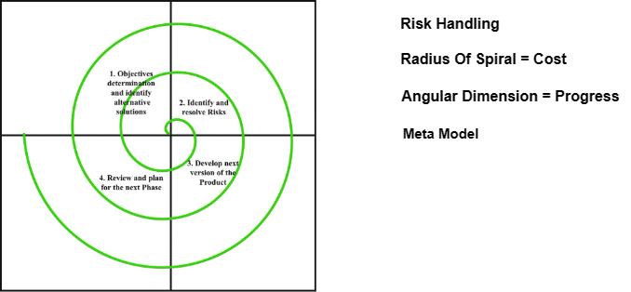
Spiral Model

Slide 26
Spiral Model
Why Spiral Model is called Meta Model?
The Spiral model is known as a Meta-Model, encompassing other SDLC models.
Single loop spiral resembles Iterative Waterfall Model.
Utilizes Prototyping Model by building prototypes in each phase for risk-handling.
Supports the Evolutionary model with iterations building the complete system.

Slide 27
Spiral Model
Advantages
Risk Handling: Addresses unknown risks during development phases.
Good for Large Projects: Recommended for large and complex projects.
Flexibility in Requirements: Allows accurate incorporation of change requests.
Customer Satisfaction: Early product development fosters customer familiarity.
Iterative and Incremental Approach: Supports flexibility and adaptability.
Emphasis on Risk Management: Minimizes the impact of uncertainty.
Improved Communication: Regular evaluations improve customer-team communication.
Improved Quality: Multiple iterations enhance software quality and reliability.

Slide 28
Spiral Model
Disadvantages
Complexity: More complex compared to other SDLC models.
Expensive: Not suitable for small projects due to high costs.
Difficulty in Time Management: Unknown number of phases makes time estimation challenging.
Time-Consuming: Involves multiple evaluations and reviews, leading to time consumption.
Resource Intensive: Requires significant investment in planning, risk analysis, and evaluations.

Slide 29
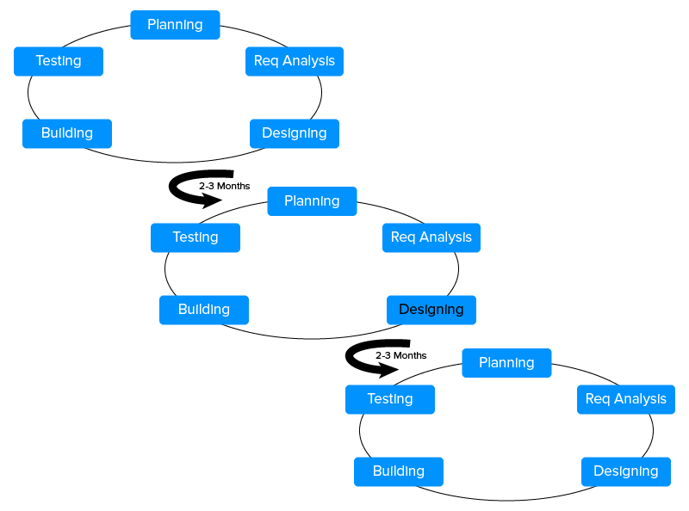
Agile model

Slide 30
Agile model
Incremental and Periodic Development: Agile follows incremental and periodic development cycles.
Continuous Improvement: Software is repeatedly improved using customer feedback.
Iterative Approach: Development life cycle divided into tiny increments or iterations.

Slide 31
Agile model
Six methods are identified as agile development methods they are following :
Crystal methodologies
Dynamic software development method
Feature-driven development
Lean software development
Scrum
Extreme programming

Slide 32
Software testing and debugging
Testing:
Purpose: Testing is the process of evaluating a software application to identify whether it meets its requirements, works as intended, and produces the expected results.
Focus: Testing focuses on assessing the functionality, correctness, and performance of the software.
When: Testing is done before and after debugging. It's an ongoing process throughout the development lifecycle.
Activities: Testing involves designing and executing test cases, comparing actual outputs with expected outputs, and verifying that the software behaves correctly under various conditions.
Outcome: The outcome of testing is to gain confidence that the software works as expected and to identify potential defects that need to be addressed.

Slide 33
Software testing and debugging
Debugging:
Purpose: Debugging is the process of identifying, isolating, and fixing defects or issues in the software that have been found during testing or use.
Focus: Debugging focuses on finding the root cause of unexpected behavior or incorrect results.
When: Debugging is done after testing uncovers issues. It's the process of investigating and resolving defects that have been identified.
Activities: Debugging involves analyzing code, logs, and data to locate the source of the problem, making necessary code changes to correct the issue, and testing the fixed code to ensure it behaves as expected.
Outcome: The outcome of debugging is to eliminate the identified defects and ensure the software functions correctly.

Slide 34
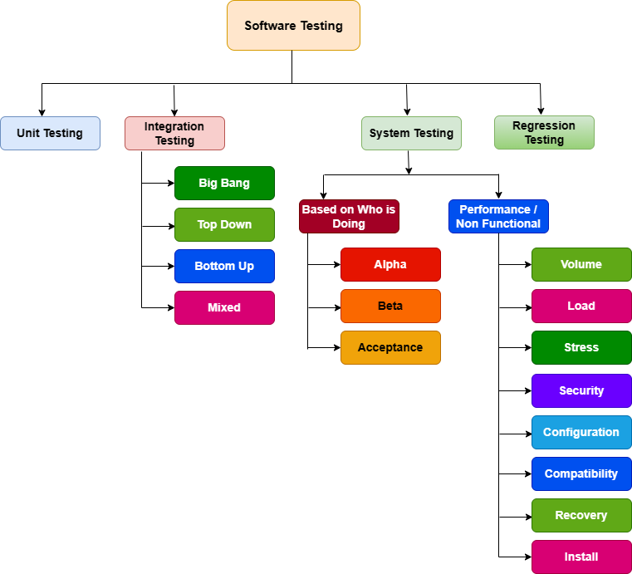

Slide 35
Testing Example:
Imagine you are building a simple calculator application that performs basic arithmetic operations (addition, subtraction, multiplication, and division). Here's how you can perform testing:
Unit Testing:
Test the "Addition" function with inputs like (2, 3) and verify that it returns 5.
Test the "Subtraction" function with inputs like (10, 5) and verify that it returns 5.

Slide 36
Testing examples cont..
Integration Testing:
Test the integration of "Addition" and "Subtraction" functions by performing a calculation like (10 + 5) - 2. Verify that it returns the correct result of 13.
System Testing:
Test the entire calculator application by performing multiple calculations with different operators (e.g., 4 + 5, 6 - 2, 3 * 4, etc.) and ensuring that all the results are accurate.
Regression Testing:
Regression testing is conducted to ensure that new code changes, updates, or enhancements do not introduce new defects or negatively impact existing functionality.

Slide 37
Debugging Example:
Suppose the calculator application is supposed to multiply two numbers, but when you input (3 * 4), it gives an incorrect result of 8. Here's how you can debug the issue:
Add Print Statements:
Insert print statements in the multiplication function to see what values are being used in the calculation:
def multiply(a, b):
print("Multiplying", a, "and", b)
return a * b

Slide 38
Debugging Example cont..
Run the Calculation:
When you calculate (3 * 4), the print statement will show: "Multiplying 3 and 4."
Identify the Issue:
The print statement helps you realize that the multiplication function is being executed, but the returned result is incorrect.
Fix the Bug:
After analyzing the code, you discover that you mistakenly implemented addition instead of multiplication. Correct the function, and it should look like this:
def multiply(a, b):
return a * b

Slide 39
Debugging Example cont..
Re-test:
After fixing the bug, re-run the test cases for multiplication (e.g., 3 * 4) to ensure that the result is now correct (12).

